Slide 1

World Happiness Data Analysis and Prediction Model
April 4, 2019
Jinghua Yao, Junlin Chen, Danny Lou,
Matt YongWook Lee and David Wang

Slide 2

Introduction

Slide 3
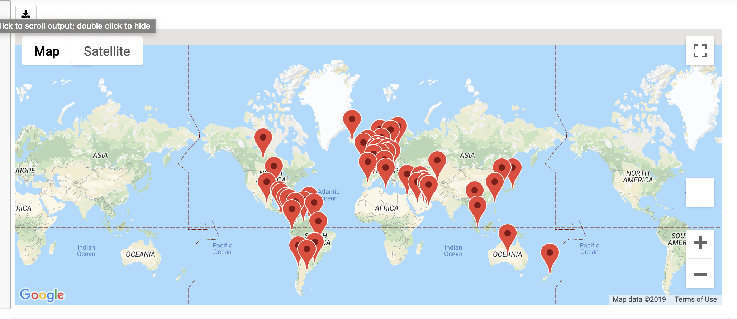
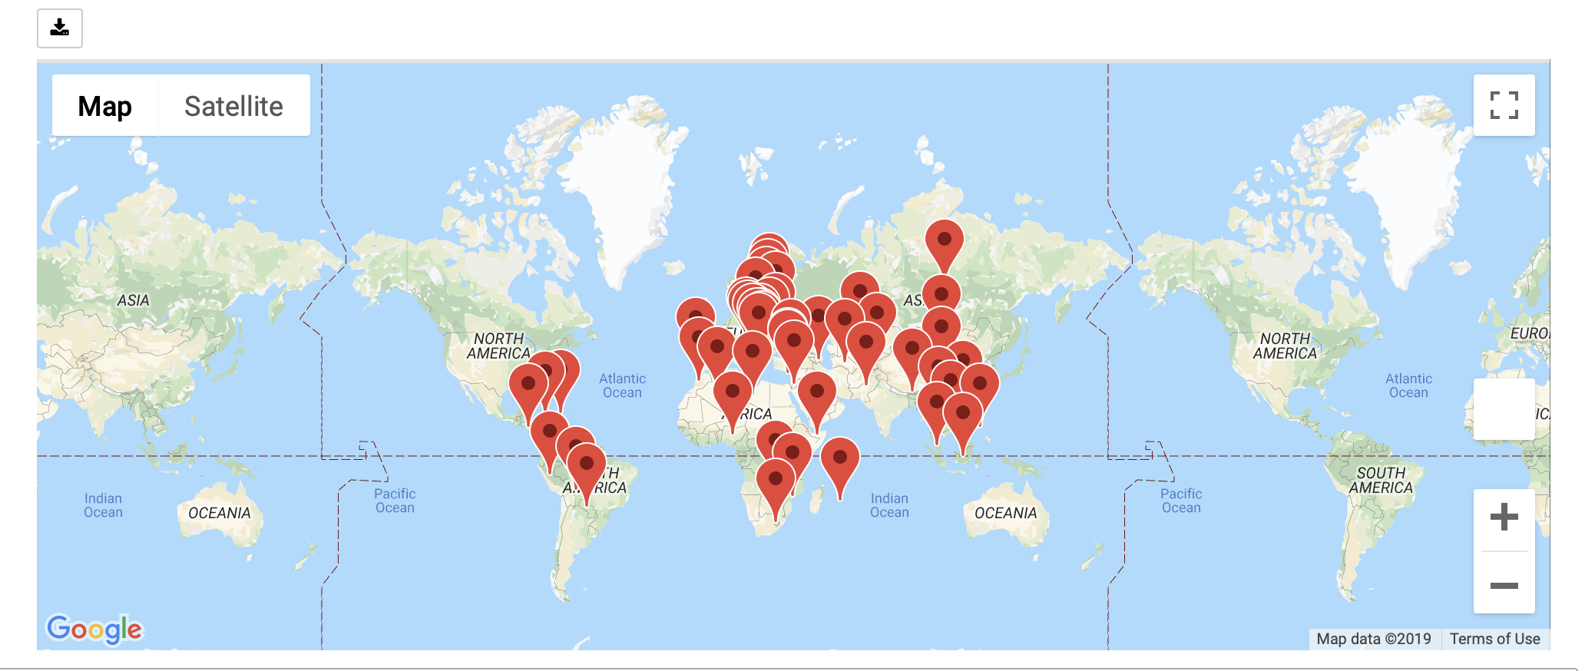
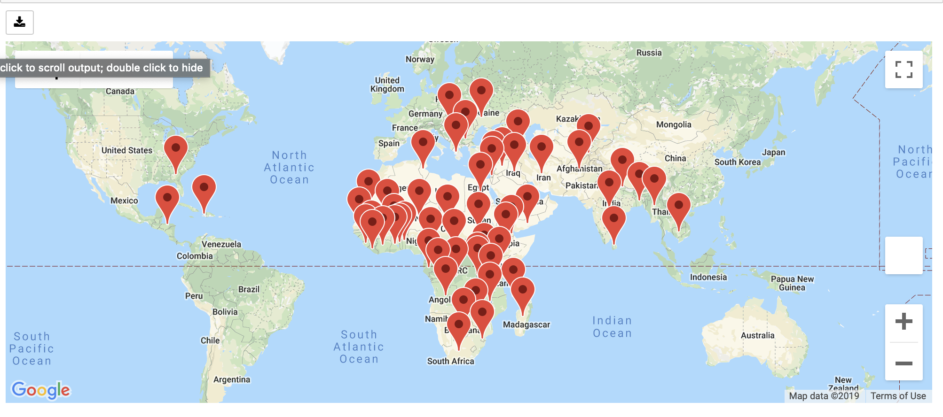
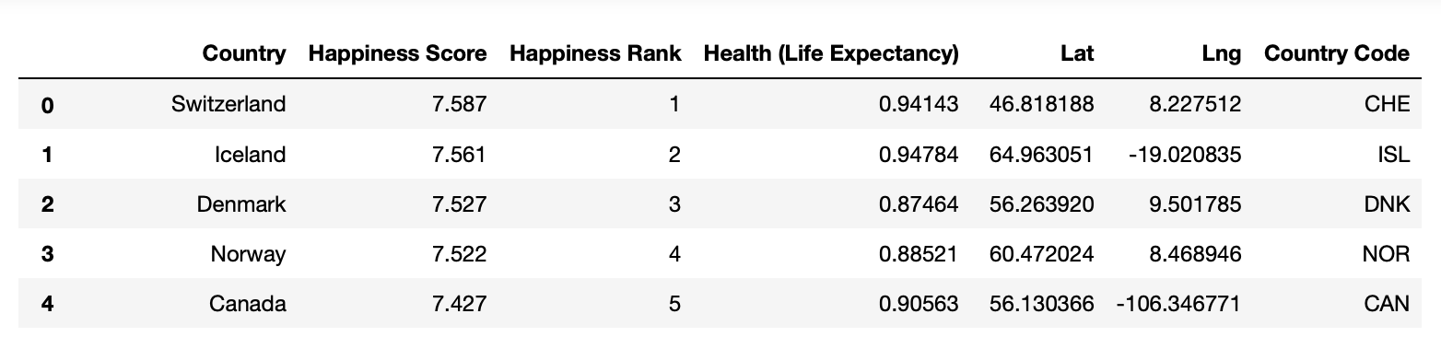
Overview Of World Happiness Ranking 2015
Part One
Top 50 Happiness Country
51-100 Happiness Country
100-158 Happiness Country
Data source:
Kaggle.com :https://www.kaggle.com/unsdsn/world-happiness#2015.csv
Gmap API request: https://maps.googleapis.com/maps/api/geocode/json?''address={0}&key={1}').format(country, gkey)
TOTAL COUNTRY:158

Slide 4
Part One
Questions To Answer
What socioeconomical factors have the best correlation with the happiness score?
Can we predict the happiness score of each country with these factors by creating a prediction model, and how?

Slide 5
Part Two
Possible Factors contribute to Happiness Score
Education (Matt YongWook Lee)
Government total expenditure on Education and School enrollment rate
Population (David Wang)
Total population, male population, female population, rural population and urban population
Economy (Junlin Chen)
GDP (Billions, PPP), GDP per Capita (PPP), Economic Freedom, Unemployment (%), Unemployment (%), Income Tax Rate (%), 5 Year GDP Growth Rate (%), Inflation (%), FDI Inflow (Millions), Public Debt (% of GDP), Property Rights……
Technology (Danny Lou)
Internet users (% of population), Cellular subscriptions, Broadband subscriptions
Health (Jinghua Yao)
Life Expectancy, Current Health Expenditure, Government Health Expenditure, Out of Pocket Expenditure, Suicide Rate

Slide 6
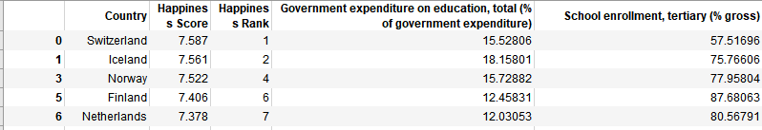
Factors in Education to Happiness score 2015
Part Two
Factors 1: Government expenditure on education, total(% of government expenditure) (WorldBank, .csv)
Factors 2: School enrollment (% gross) (WorldBank, .csv)
Factors 3: Literacy Rate Adult total (%of people ages 15 or older) (WorldBank, .csv)
Tool: Data Collection and cleaning by using Pandas

Slide 7
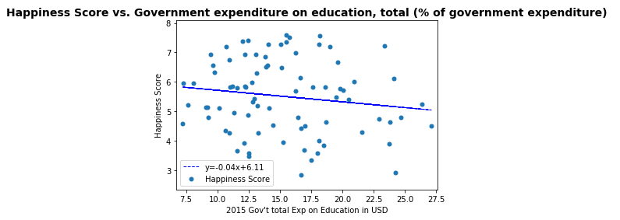
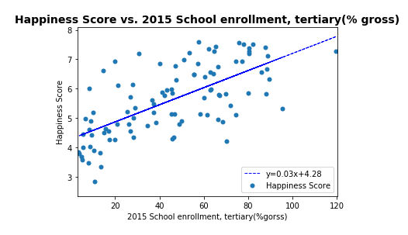
Education Factors vs. Happiness Score 2015
Part Two
Methods:
Scatter plotting by Matplotlib,
Scatter Chart, Linear Regression

Slide 8
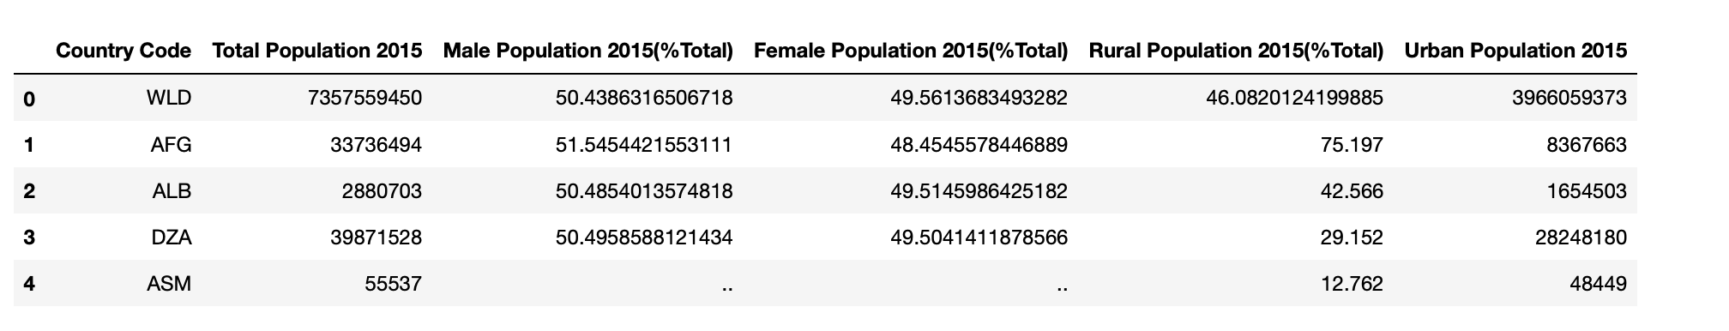
Factors in Populations to Happiness score 2015
Part Two
Data Collection and Sources:
World Populations ( World Bank, csv )
Population Male %Total ( World Bank, csv )
Population Female %Total ( World Bank, csv )
Rural Population % Total ( World Bank, csv )
Urban Population ( World Bank, csv )

Slide 9
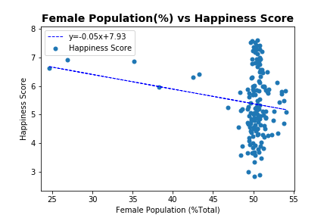
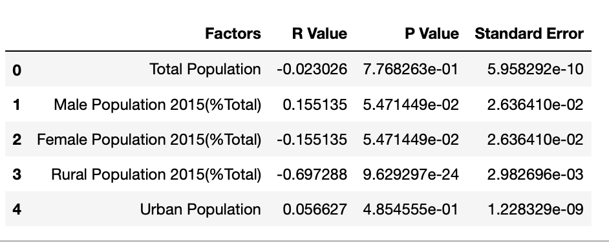
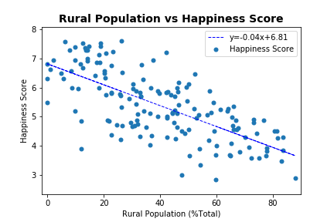
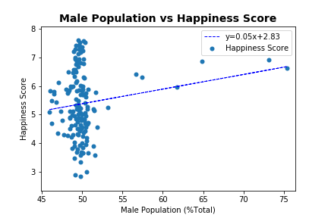
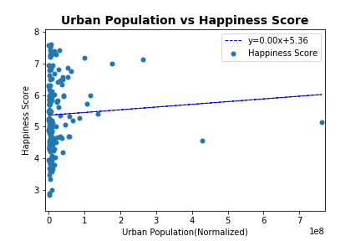
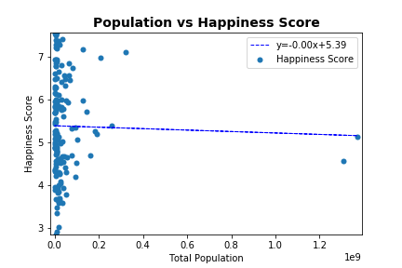
Factors in Populations to Happiness score 2015
Part Two
Factors in Populations to Happiness score 2015

Slide 10
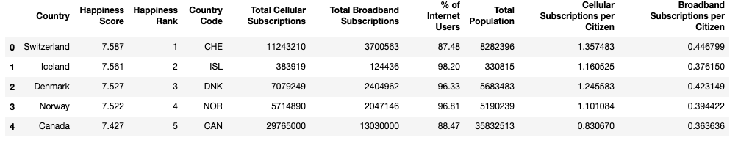
Technology Factors vs. Happiness score 2015
Part Two
Data Collection and organization using pandas
Internet Users (% of population) (Worldbank, csv)
Total Cellular Subscriptions (Worldbank, csv)
Total Broadband Subscriptions (Worldbank, csv)
Population (Worldbank, csv)
Divide totals data by population to calculate subscriptions per citizen

Slide 11
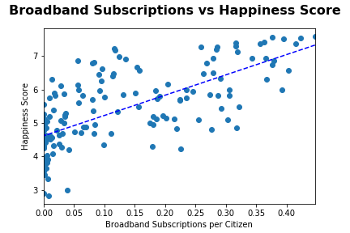
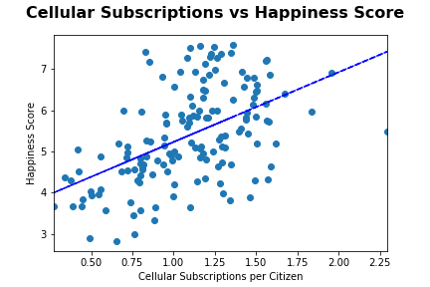
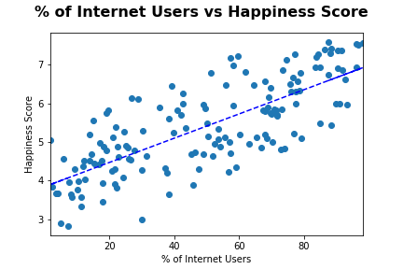
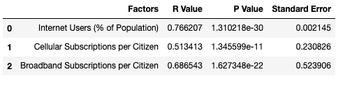
Technology Factors vs. Happiness Score 2015
Part Two
Methods:
Scatter plotting by Matplotlib,
Linear Regression

Slide 12
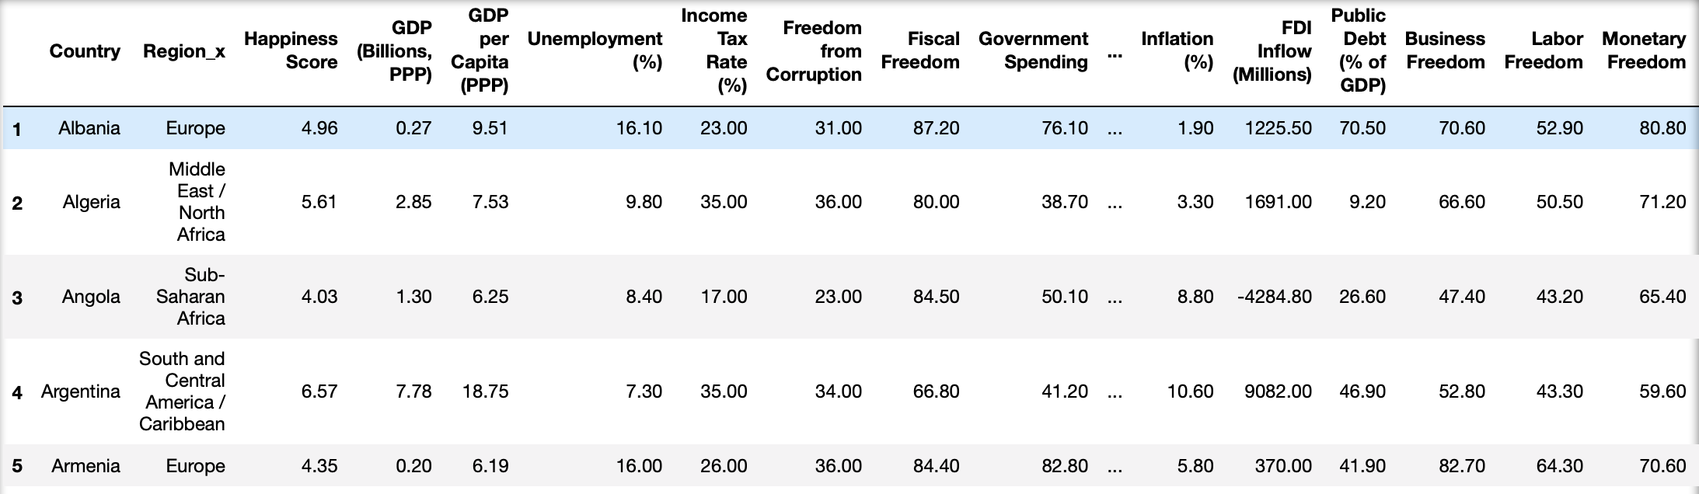
Economy Factors vs. Happiness Score 2015
Part Two
23 Factors:
Fiscal : GDP (Billions, PPP), GDP per Capita (PPP), Government Spending, Government Expenditure % of GDP; GDP Growth Rate (%), 5 Year GDP Growth Rate (%), Inflation (%), Public Debt (% of GDP),
Taxation: Tariff Rate (%), Corporate Tax Rate (%), Income Tax Rate (%), Tax Burden % of GDP ;
Economy Freedom Index: Business Freedom, Labor Freedom, Monetary Freedom, Trade Freedom, Investment Freedom, Financial Freedom, Freedom from Corruption, Fiscal Freedom;
Employment: Unemployment (%);
Others: Property Rights, Cost of living

Slide 13
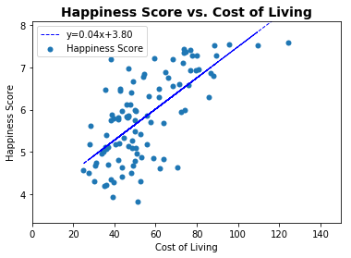
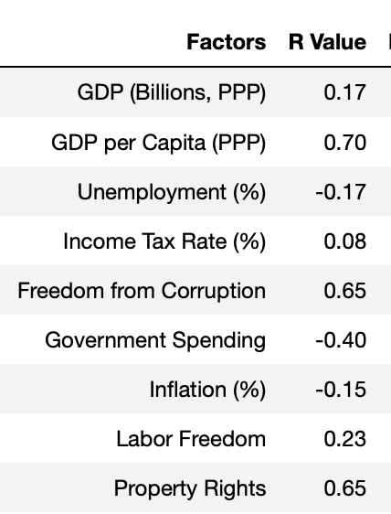

Economy Factors vs. Happiness Score 2015
Part Two

Slide 14
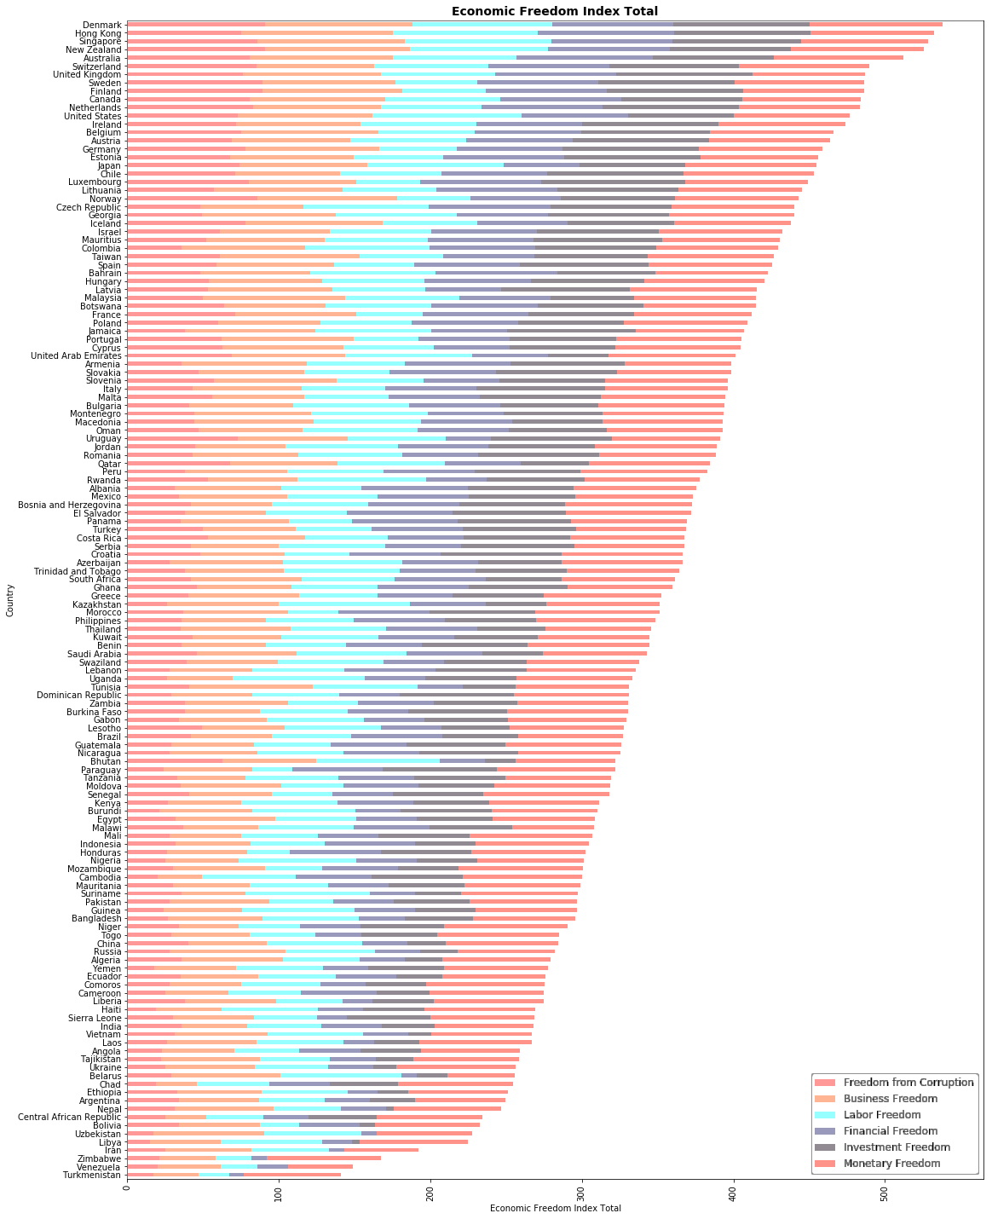
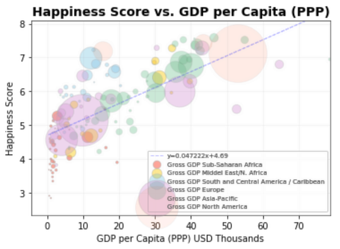
Economy Factors
Part Two

Slide 15
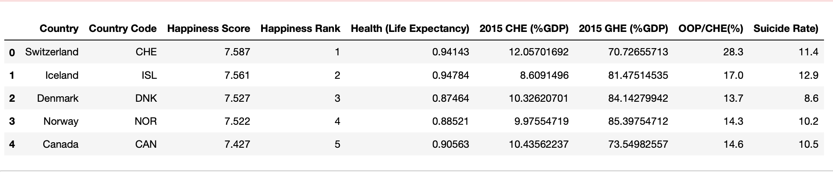
Factors in Healthcare to Happiness score 2015
Part Two
Data Collection and organization using pandas and API request
Life Expectancy (Kaggle, csv)
Current Health Expenditure( %GDP)(Worldbank, csv)
Government Health Expenditure(%GDP)(Worldbank, csv)
Out of Pocket Expenditure(%GDP) (WHO, API request)
Suicide Rate (WHO,API request)

Slide 16
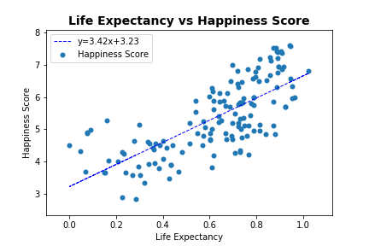
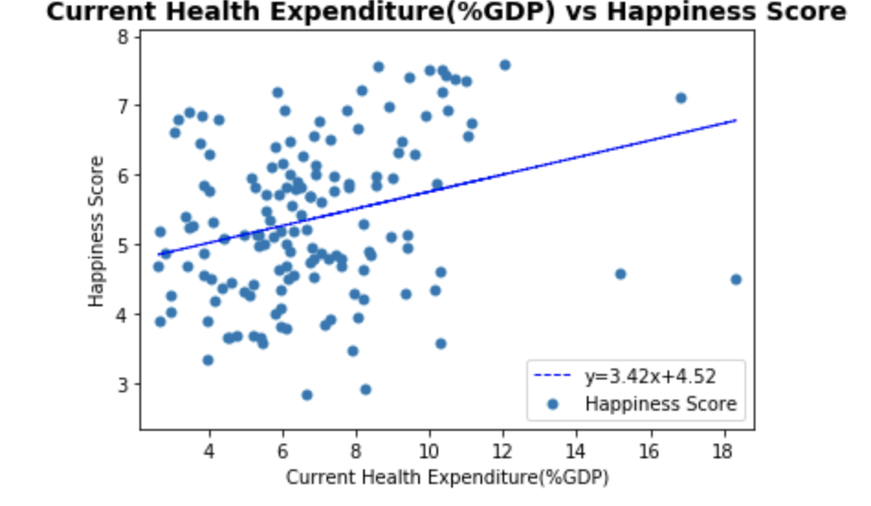
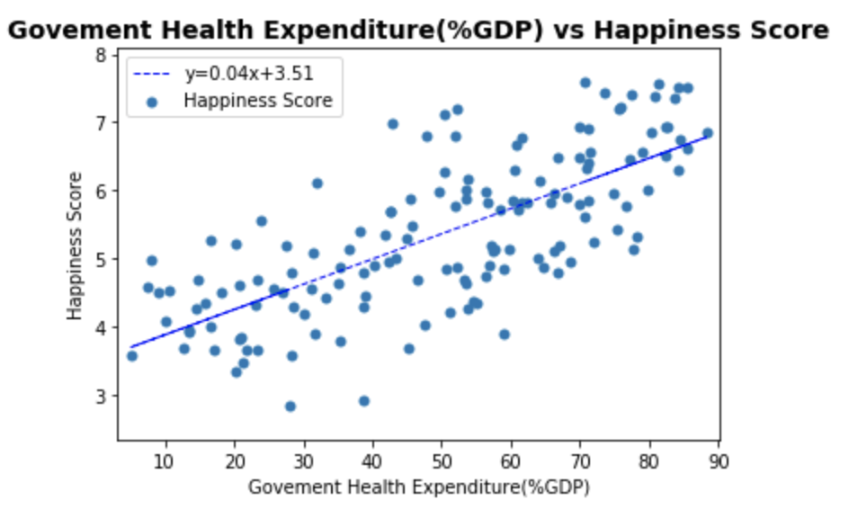
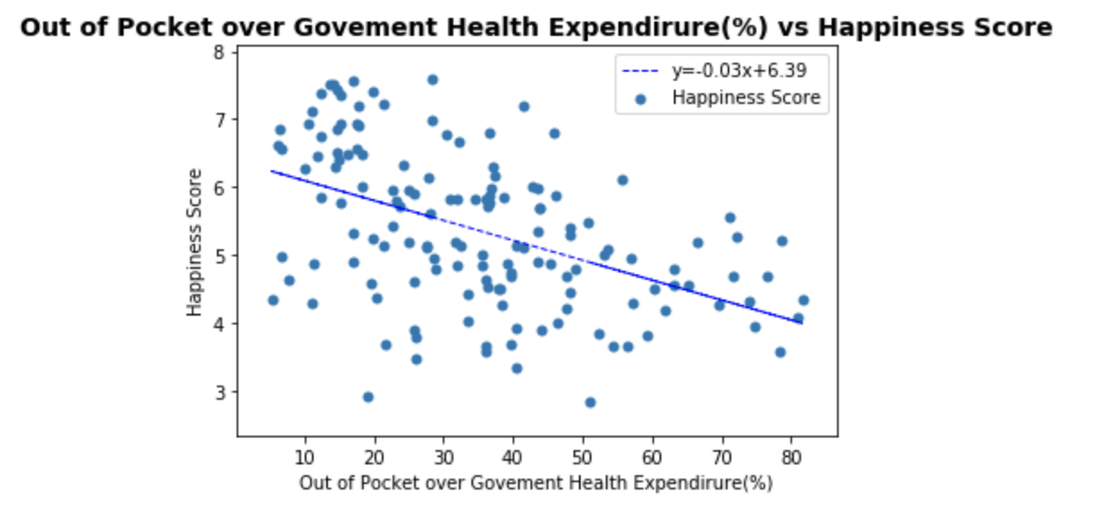
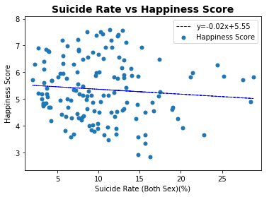
Health Factors to Happiness Score 2015
Part Two
Methods:
Scatter plotting by Matplotlib, Linear Regression

Slide 17
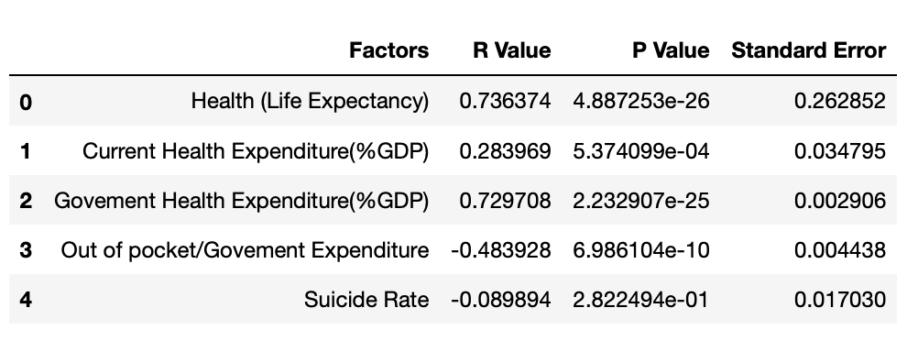
Statistic of Health Factors
Part Two
Positive Control
Best Factors in Health: Government Health Expenditure(%GDP)

Slide 18
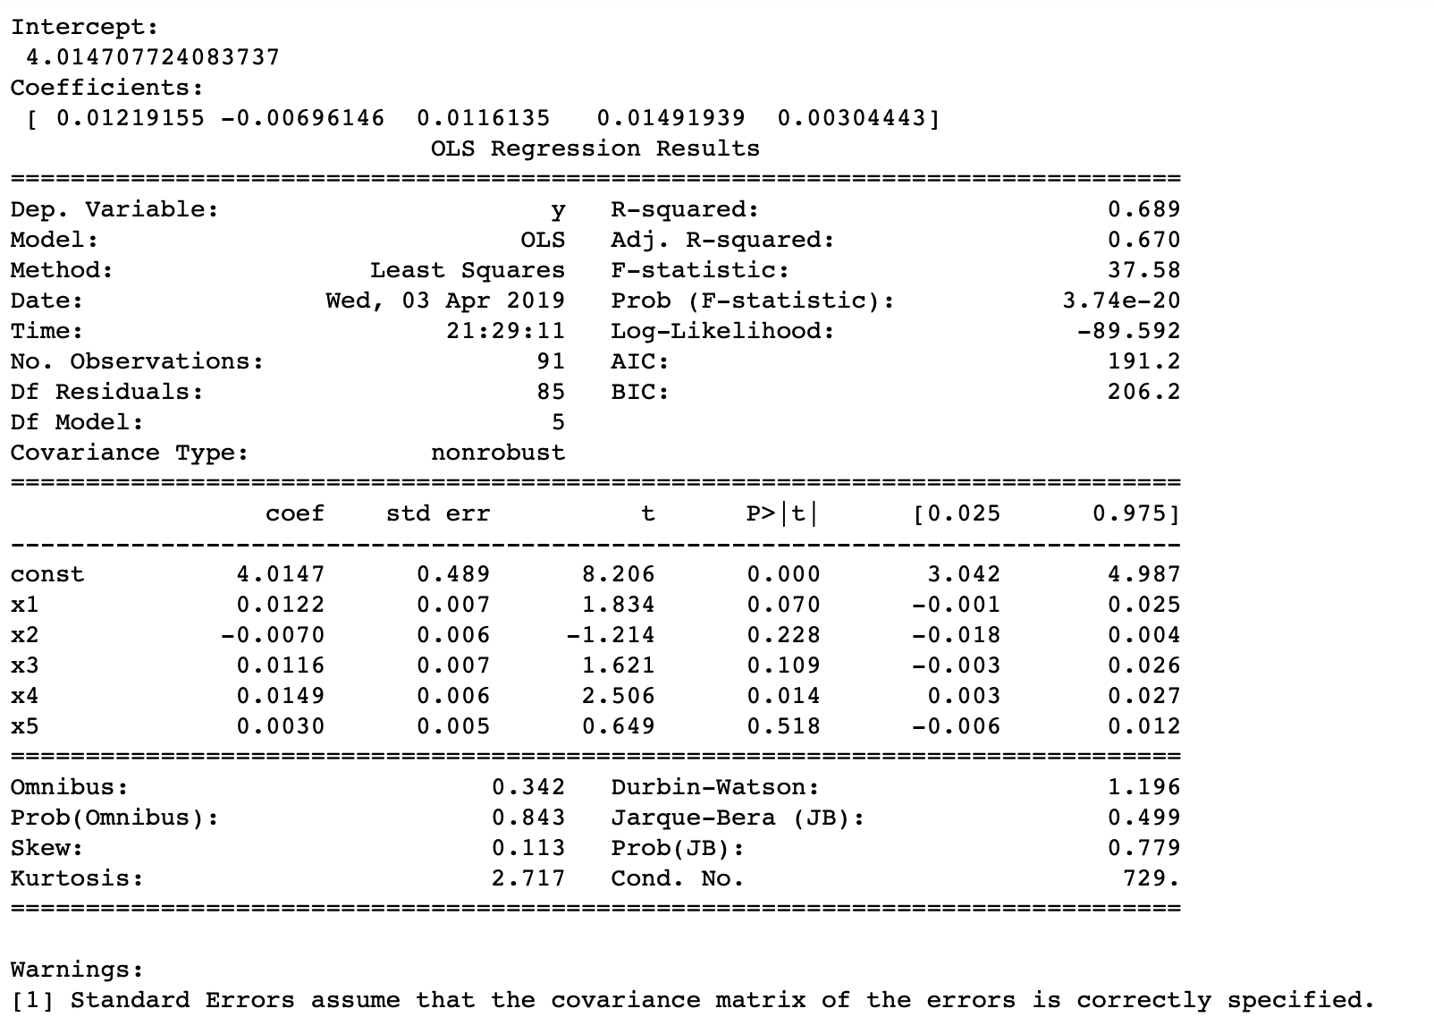
Happiness Value Prediction Model
Part Three
Methods: statsmodels.regression.linear_model.OLS
Y= Happiness Score
X1= Internet Users (% of population)
X2= Rural Population (% Total)
X3= GDP Per Capita (PPP)
X4= Government Health Expenditure(GHE) (%GDP)
X5= School enrollment (% gross)
Model:
Y=0.0122X1-0.007X2+0.0116X3+0.0149X4+0.003X5+4.0147

Slide 19
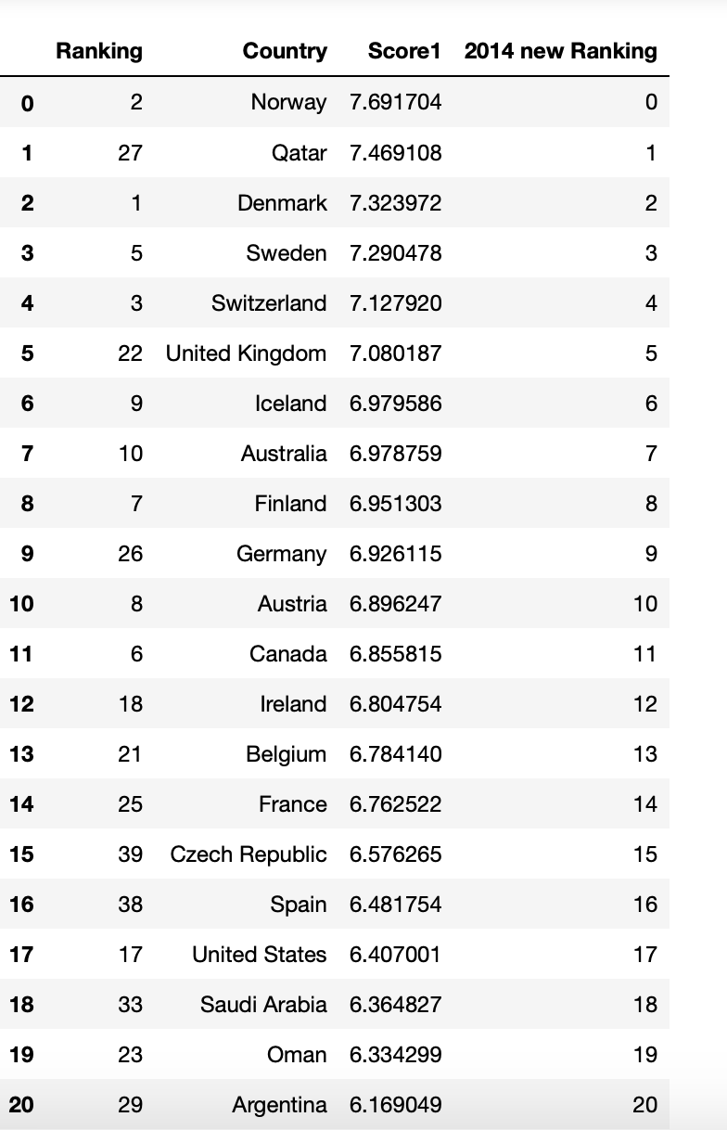
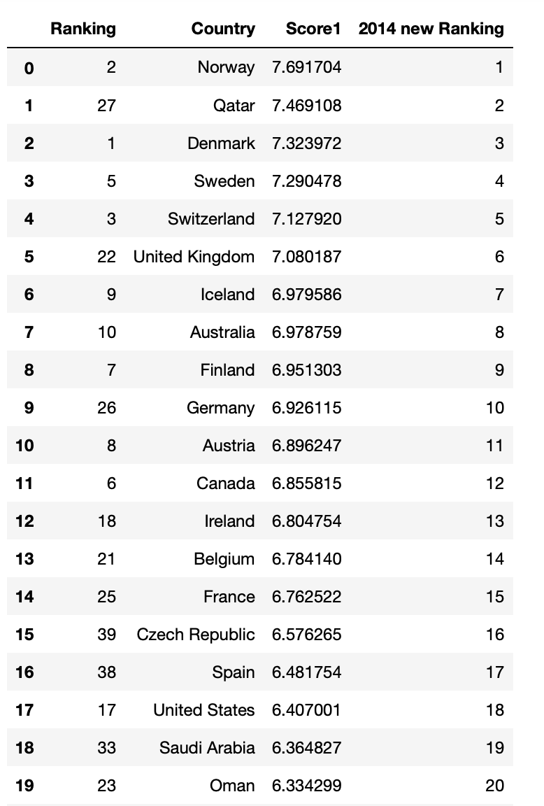
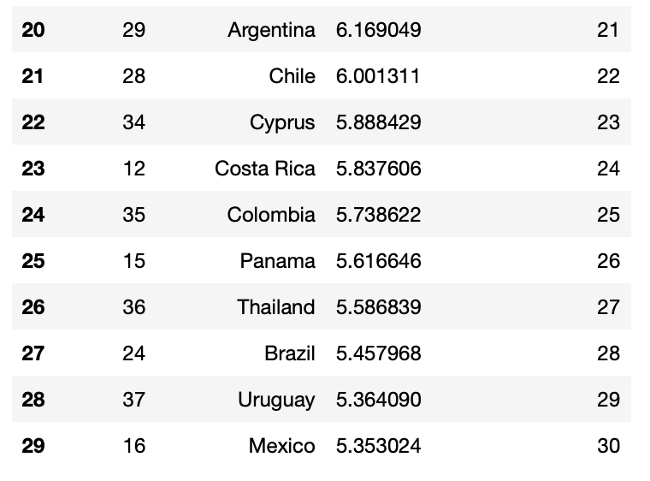
Model Testing on 2014 World Happiness Score
Part Three
Test Sample: Data of 2014 Top 30 Happiness Score by Country
Methods: sklearn, regr.predict

Slide 20

Conclusion
1. We are able to build a model to predict Happiness Score with multiple factors
2. Accuracy of the model may depend on the comprehensive level of factors
3. Data size is also important to accuracy of the model
Challenge
Collecting Data of same year

Slide 21
Challenge
Collecting Data of same year of different field
Data munging, Country name is different from different resources and need to add country code for data merging

